Slide 1
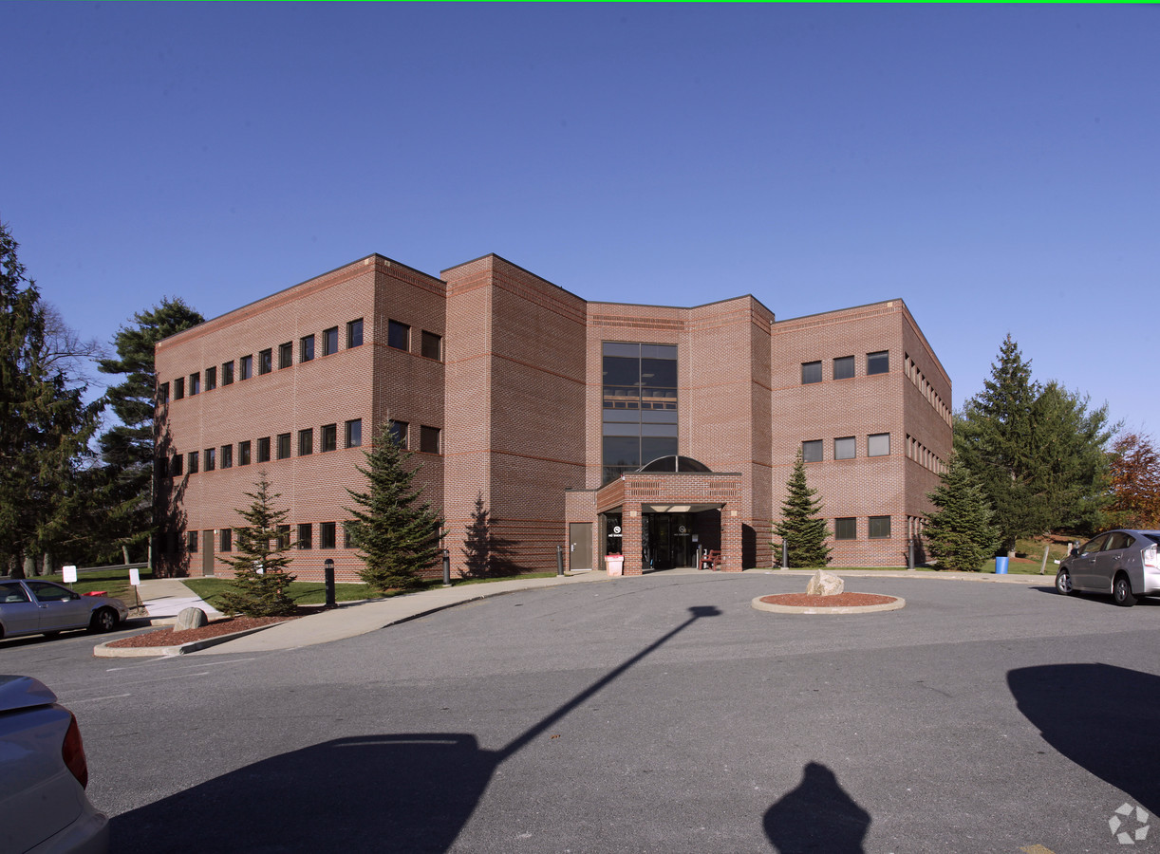
Little Things Dr. Lokhandwala- Consultant Endocrinologist

Slide 2
"Little Things" is a 19th-century poem by Julia Abigail Fletcher Carney, written in Boston, Massachusetts.
Little drops of water,
Little grains of sand,
Make the mighty ocean
And the pleasant land.
Thus the little minutes,
Humble though they be,
Make the mighty ages
Of eternity.

Slide 3
Small changes can make a
BIG DIFFERENCE

Slide 4
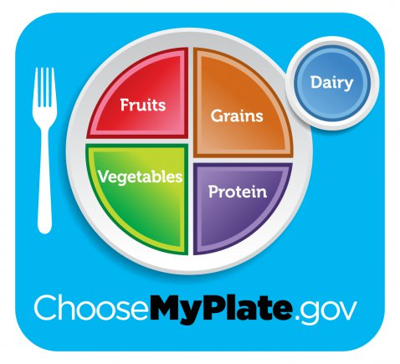
Plate diet

Slide 5
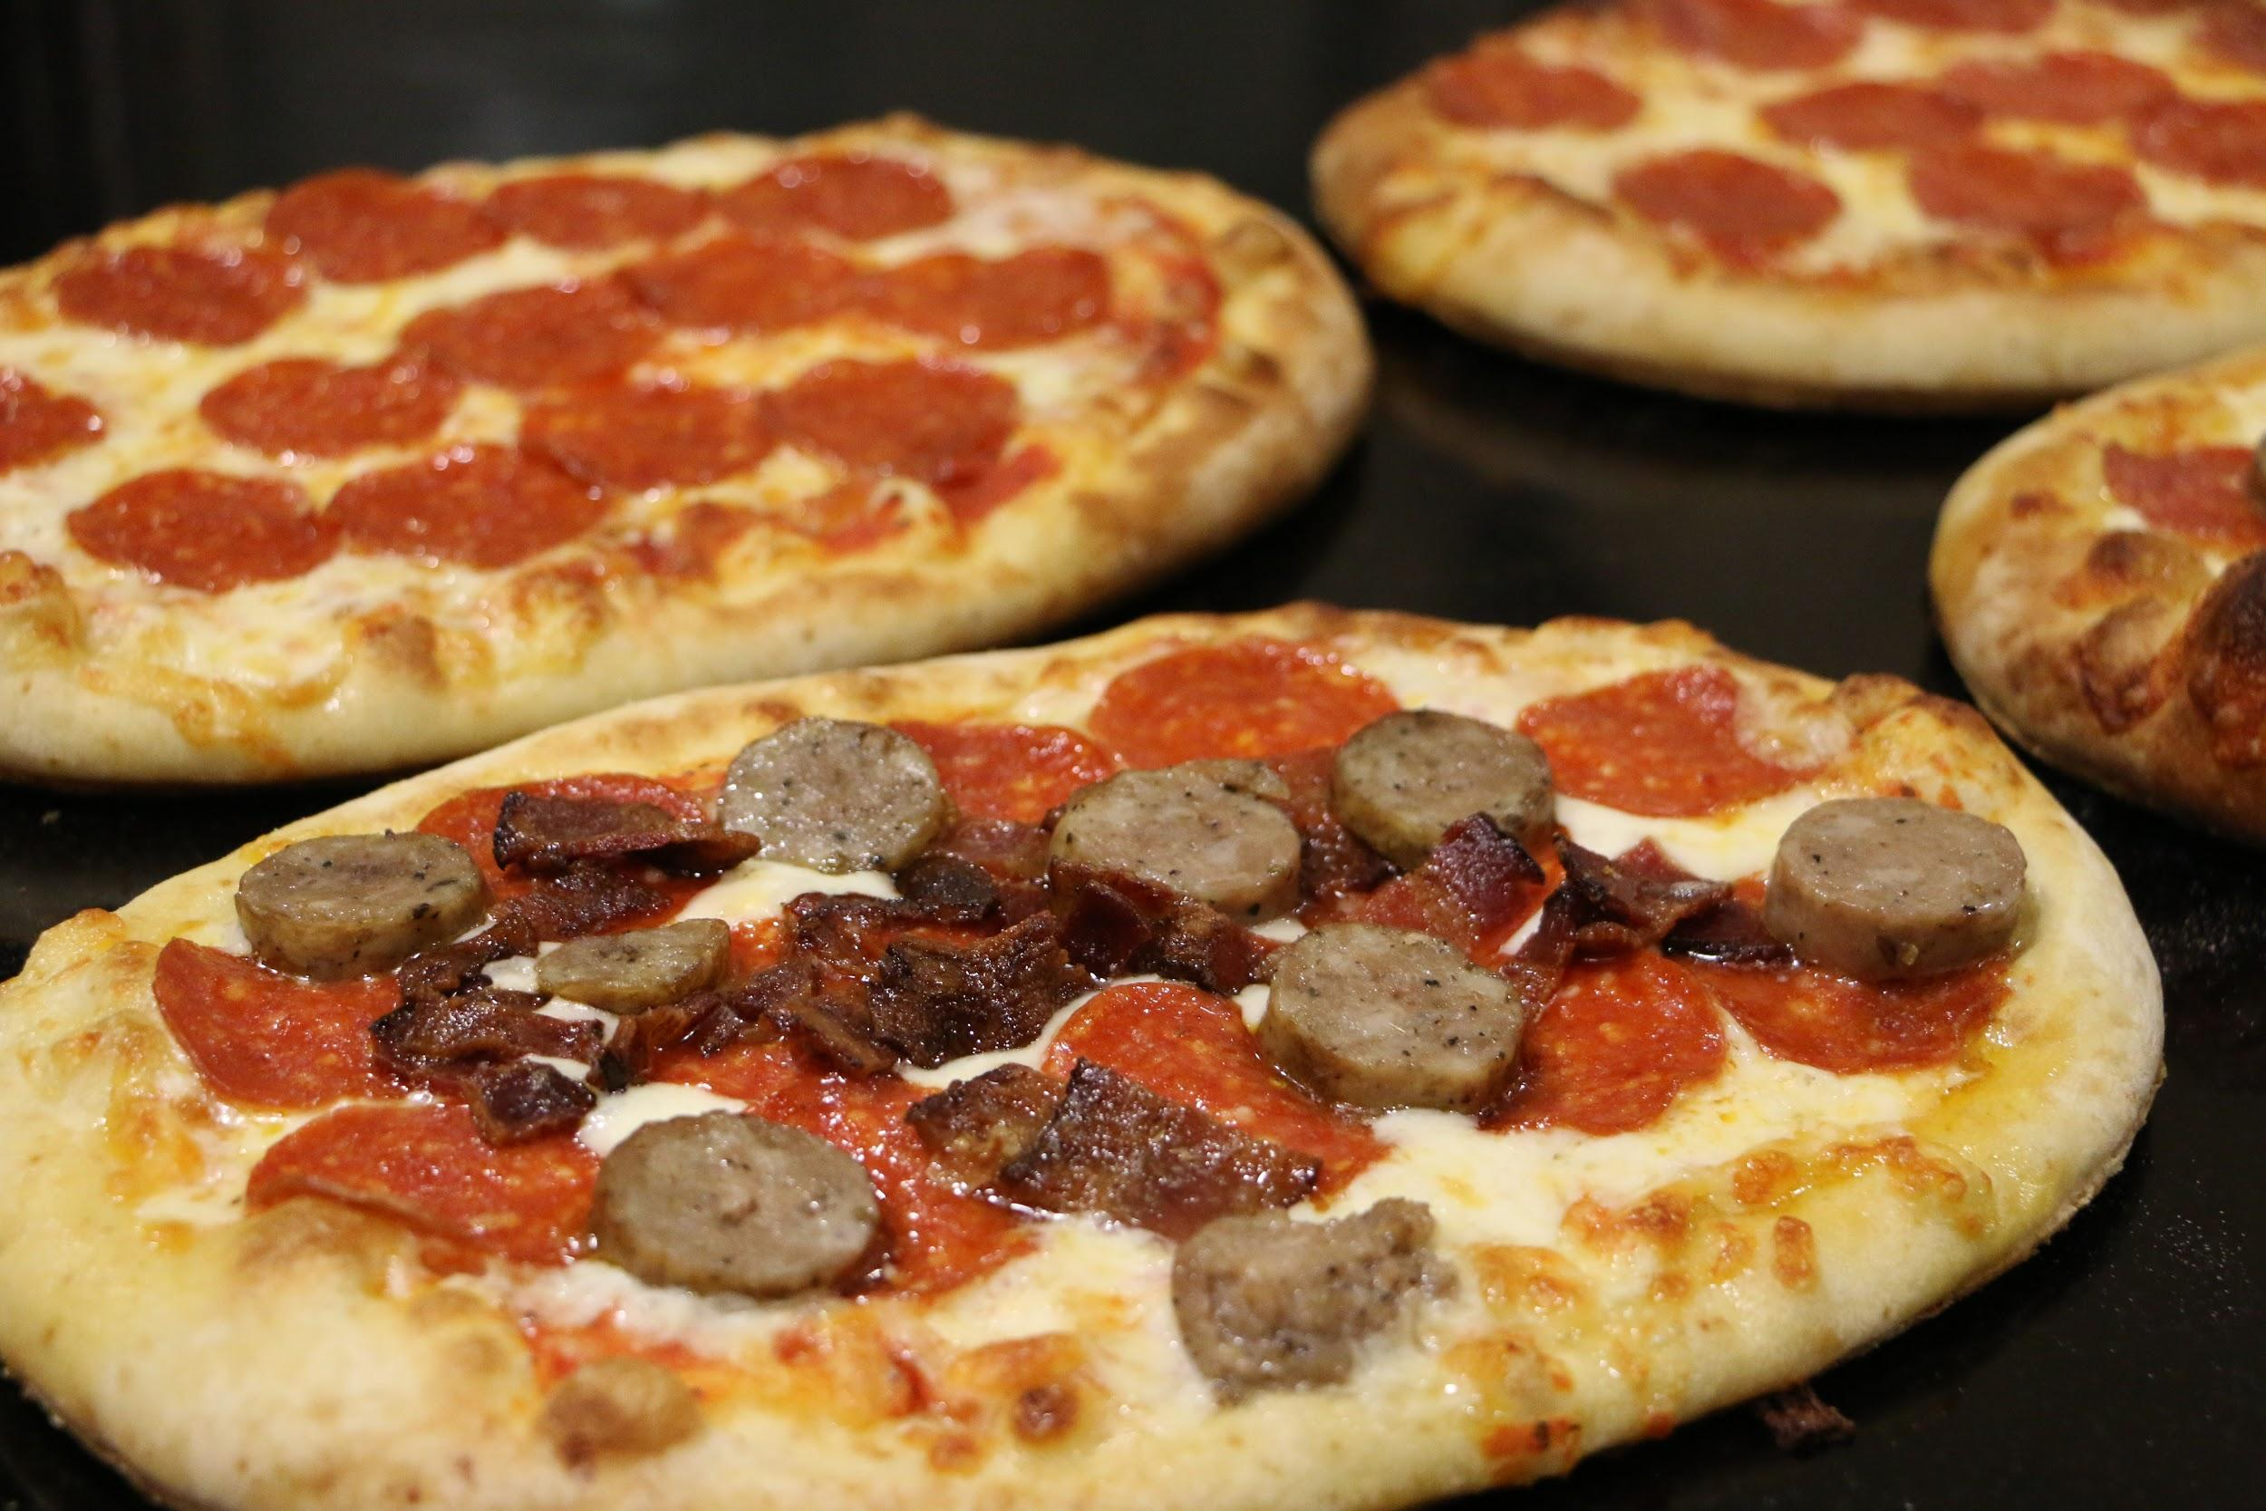
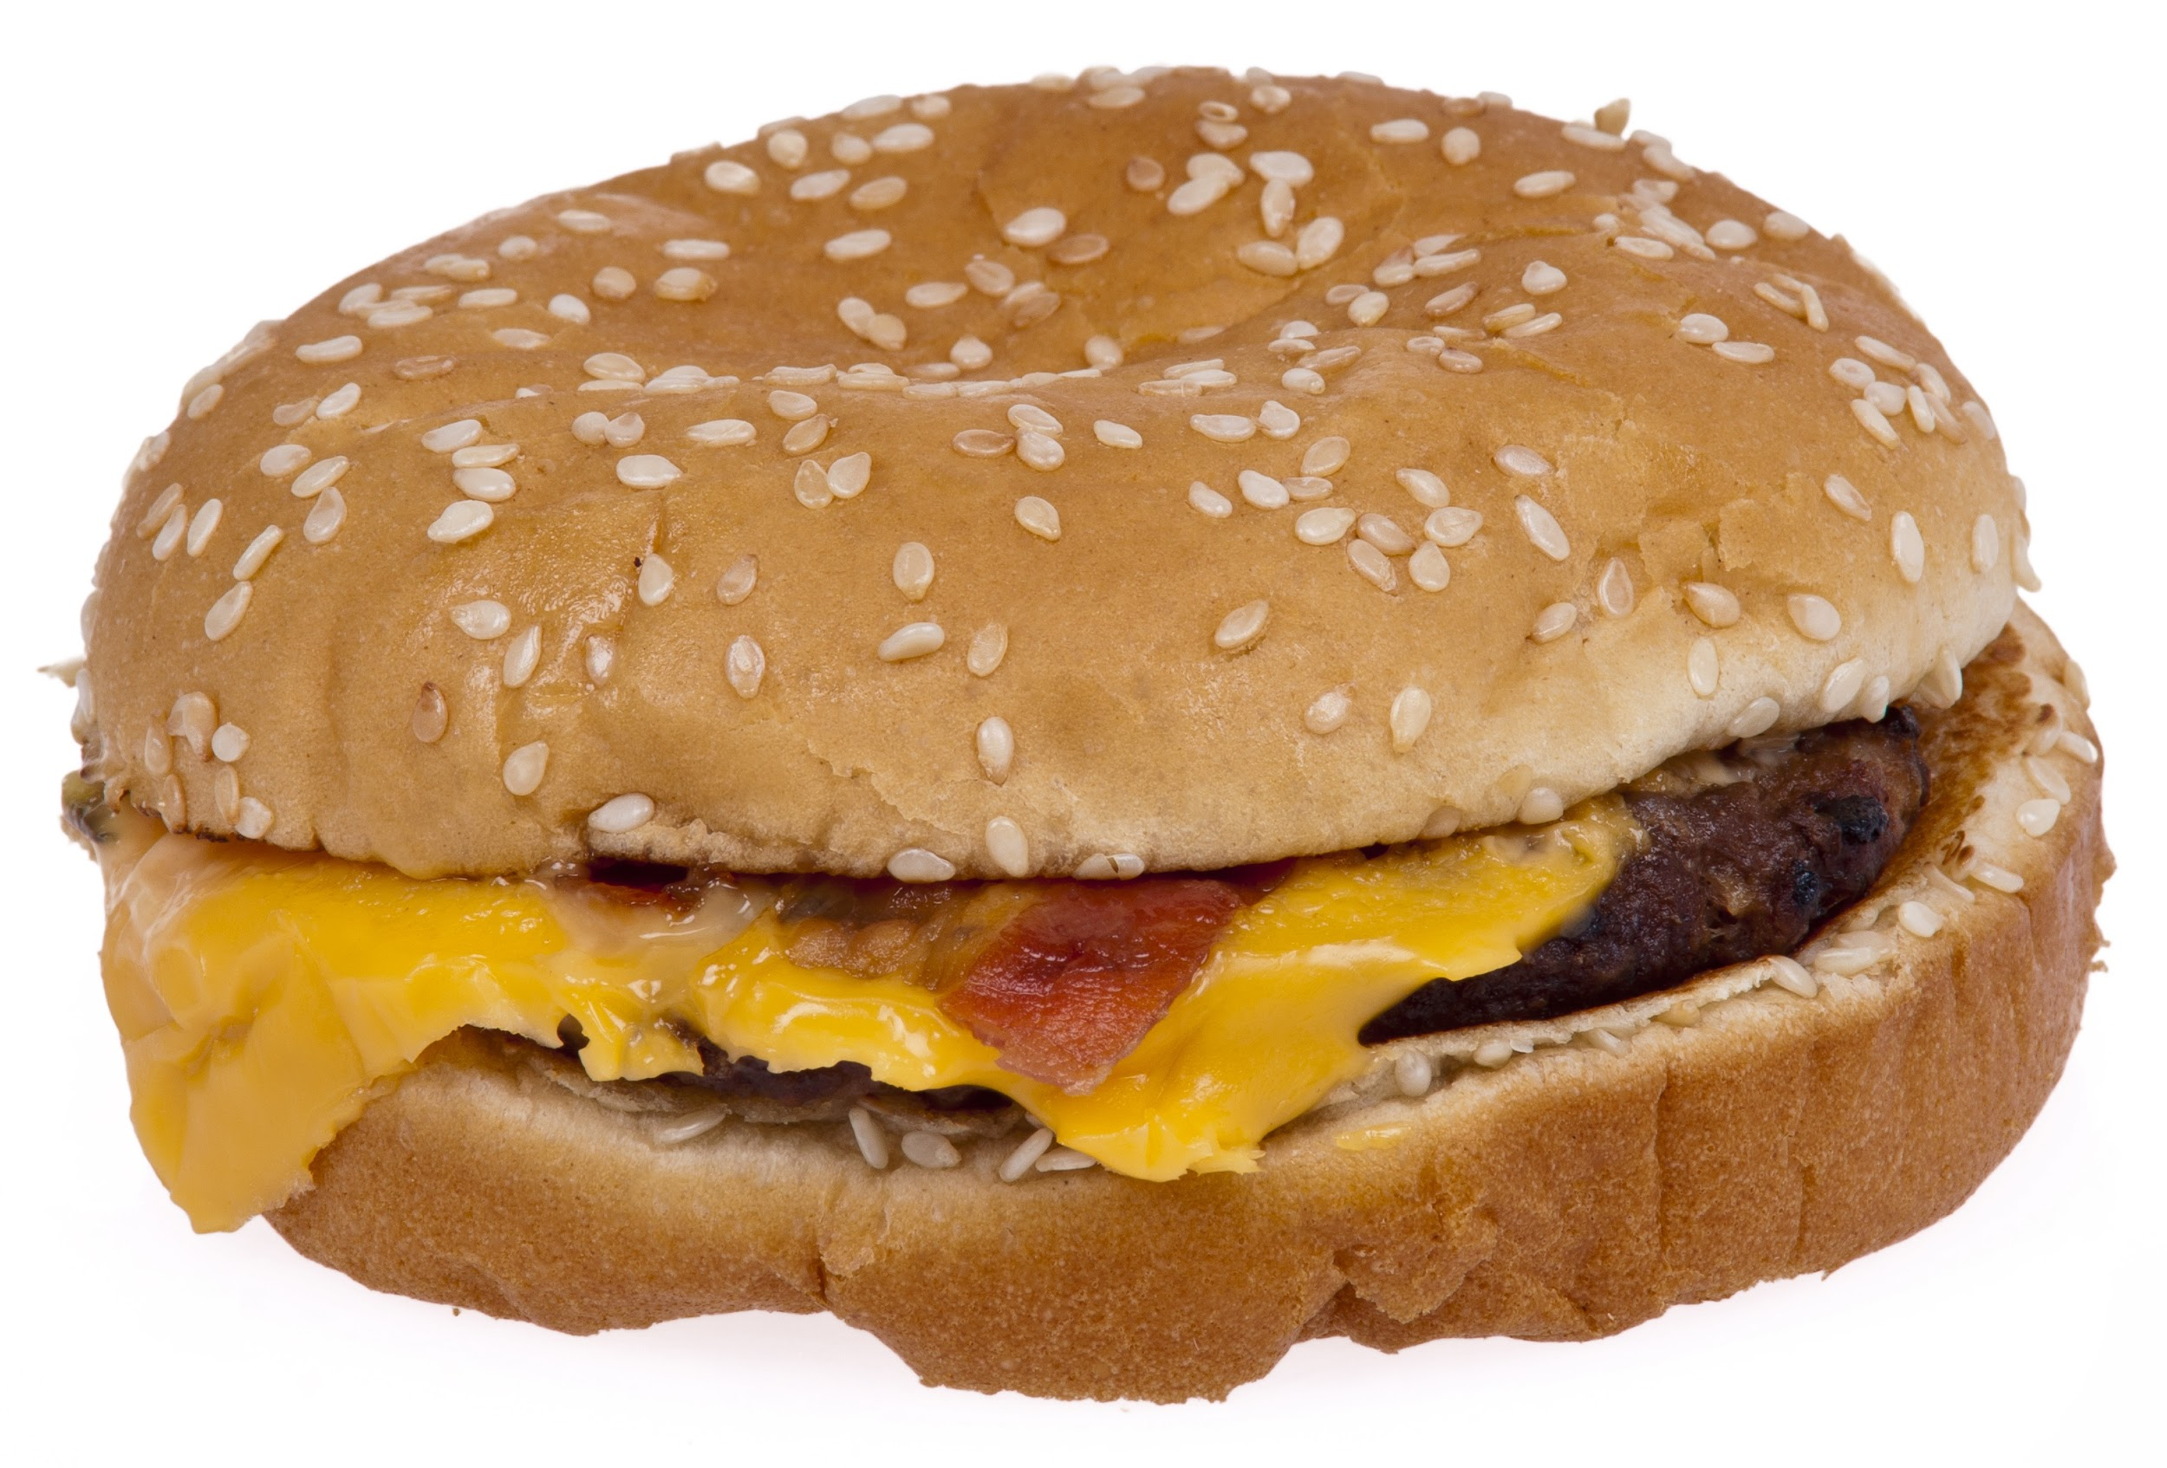
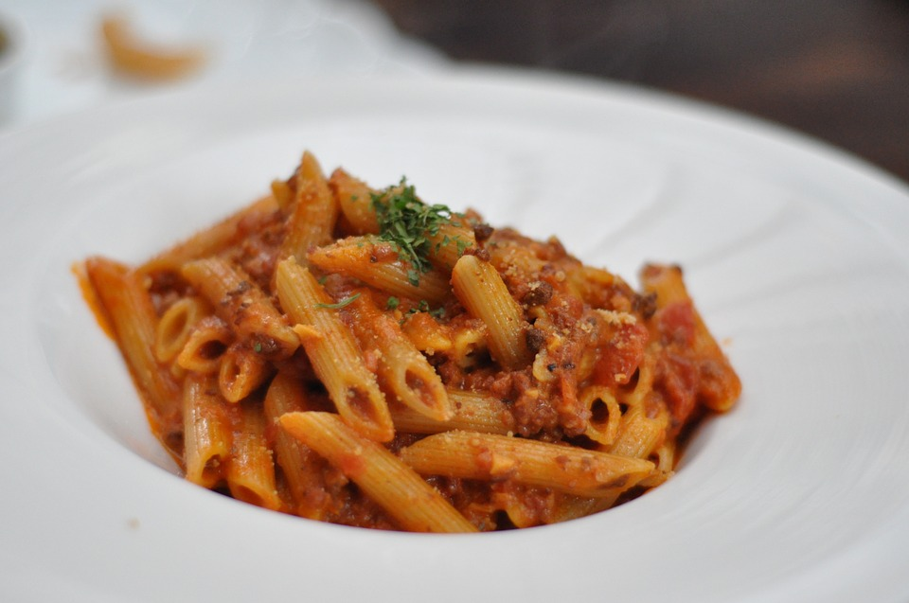
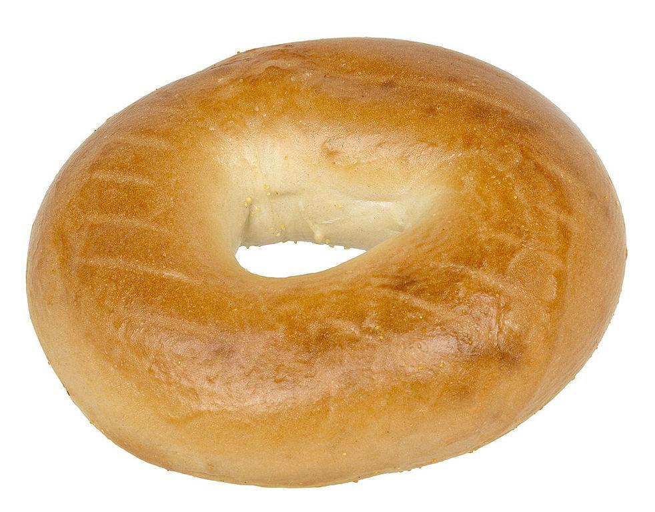
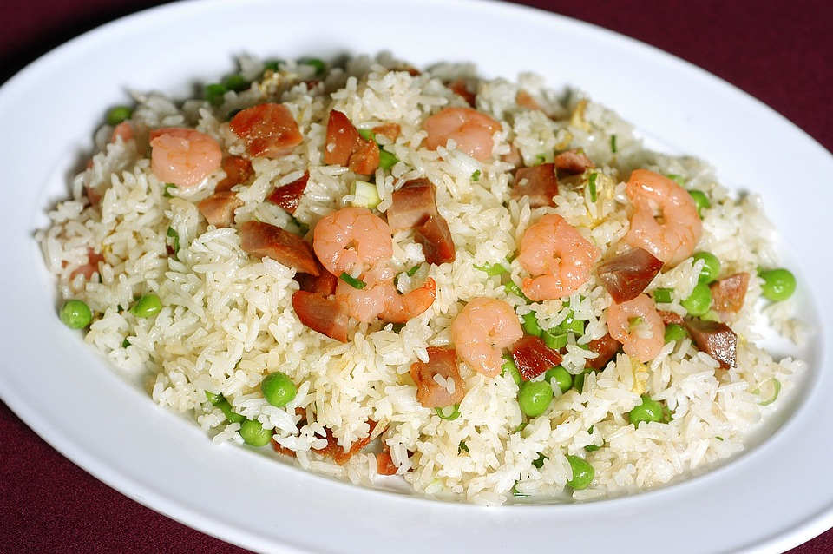
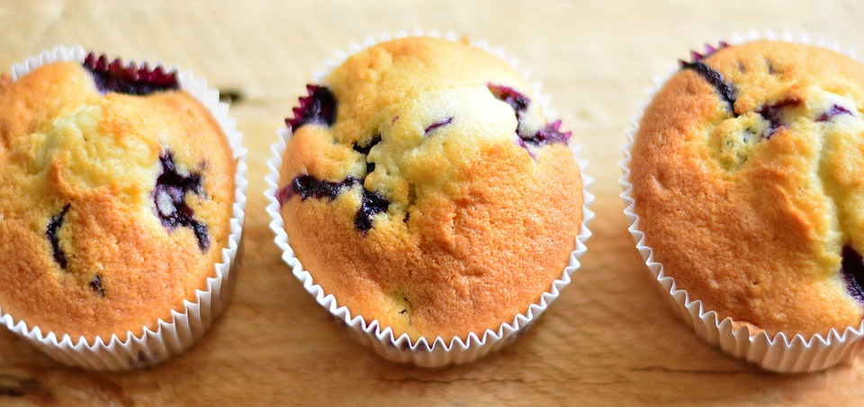
Carbohydrates everywhere !

Slide 6
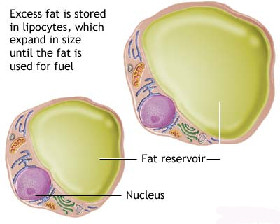
Carbohydrates can turn into a fat cell
Too many carbohydrates, stimulate insulin.
Insulin shifts glucose out of blood stream
and into a fat cell.
Fat cells store excess calories.
If you don’t use the calories it gets stored.
Fat cells make harmful chemical mediators,
Increasing inflammation and insulin
resistance.

Slide 7
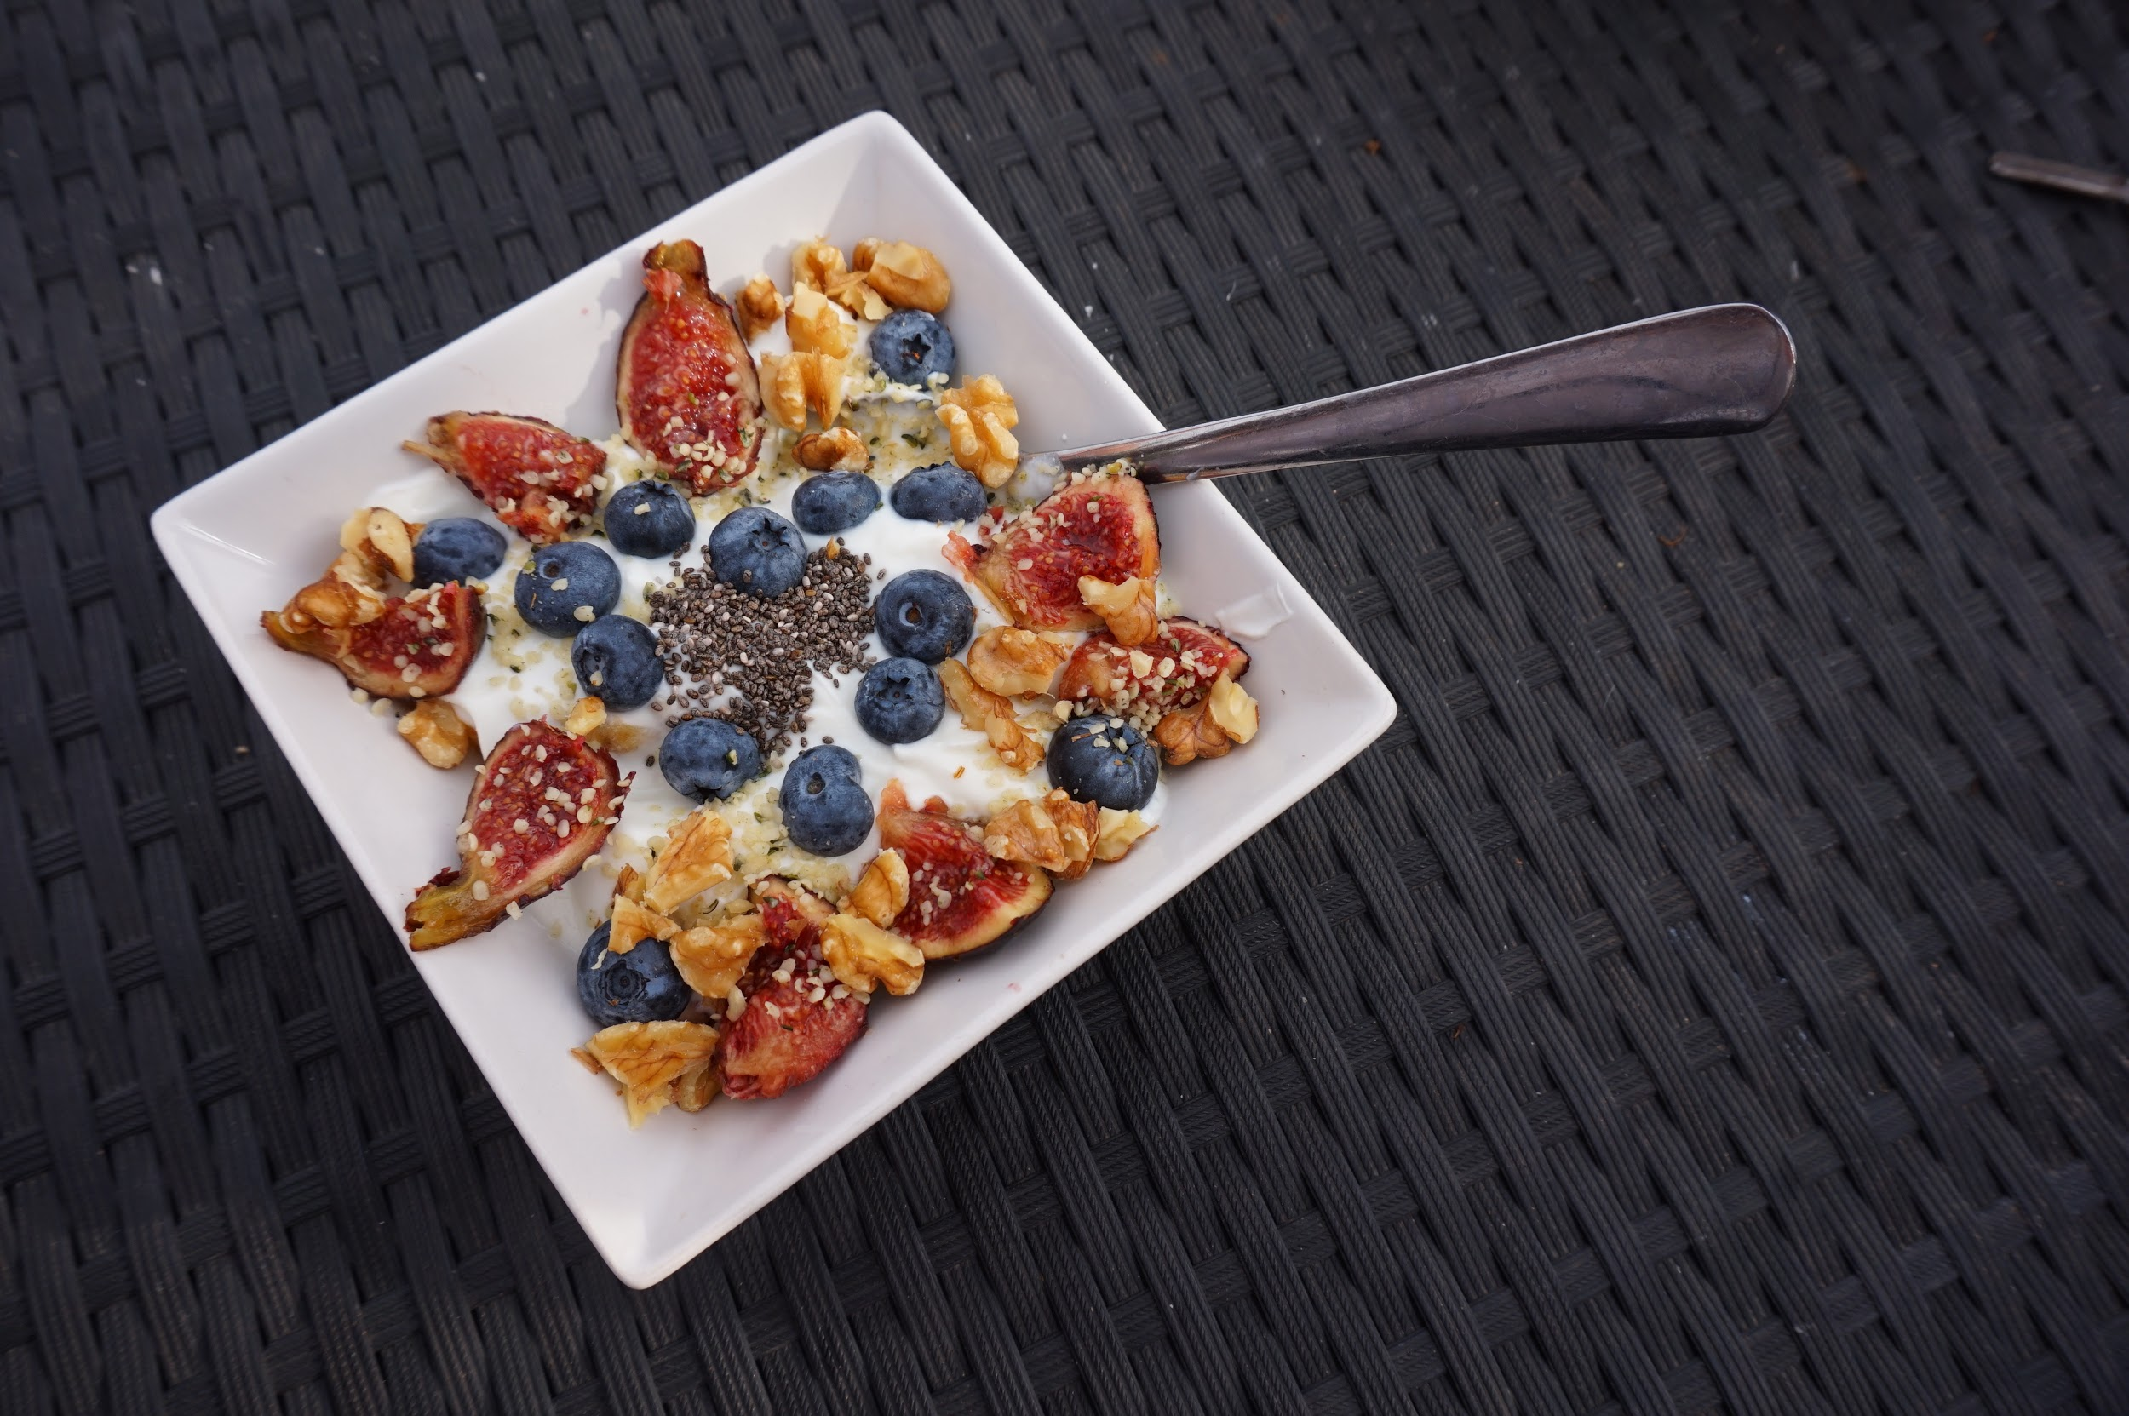
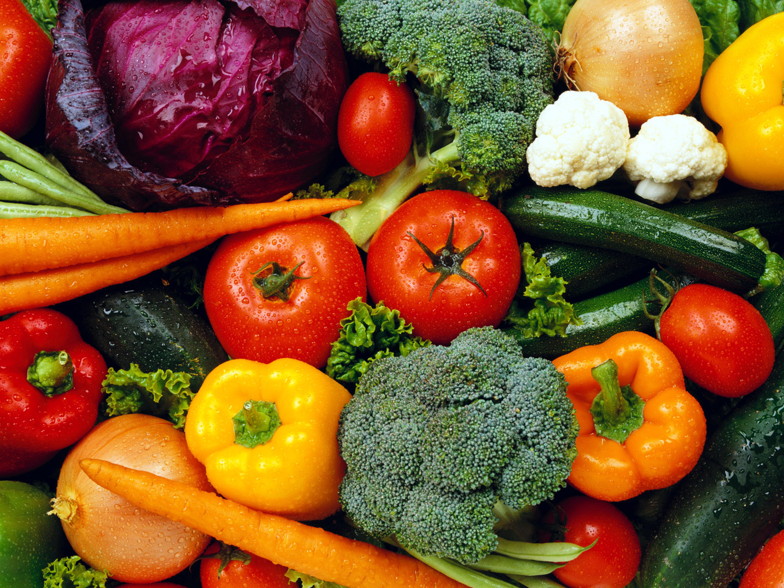
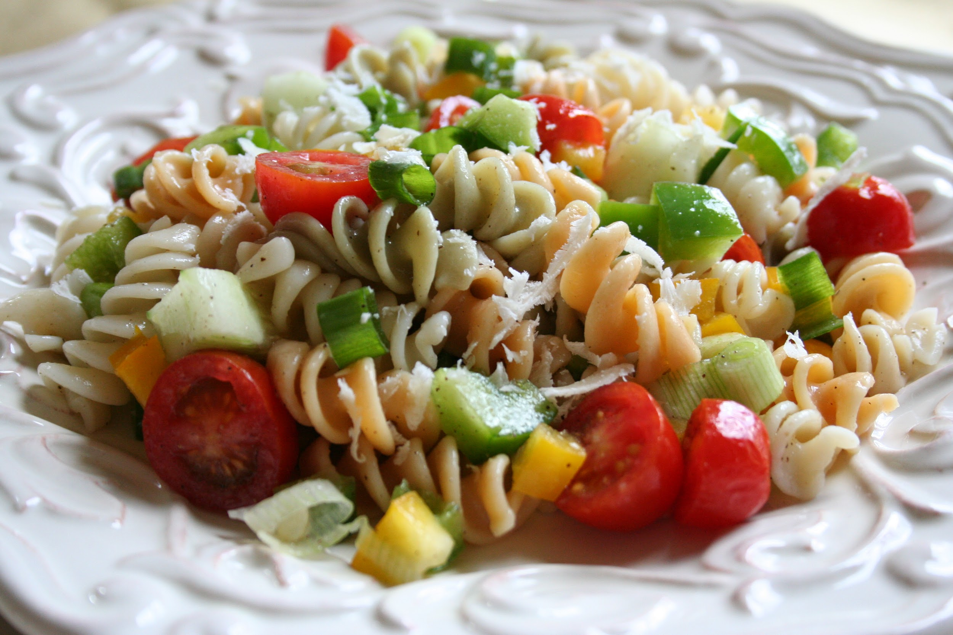
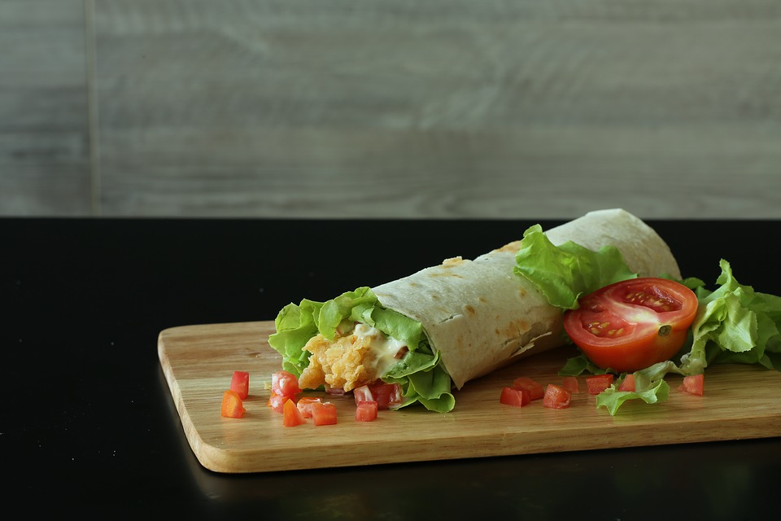
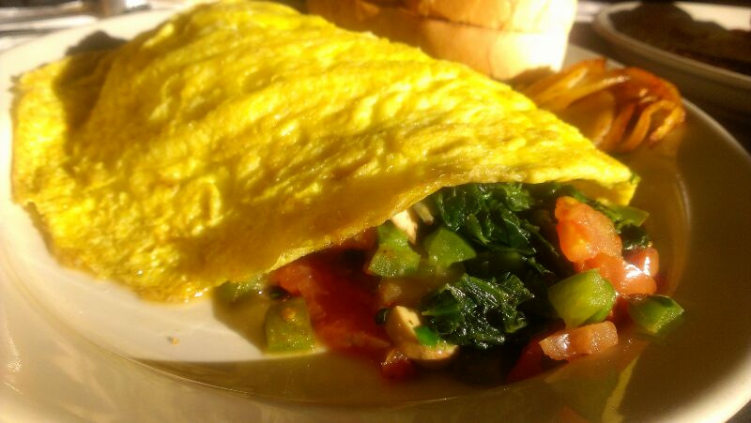
Need to eat your veggies ( and fruits ) !

Slide 8
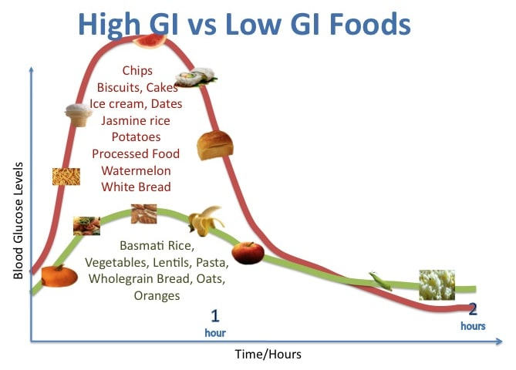
Glycemic load

Slide 9
Small things… small changes…. accumulate
Take account
Identify 1 or 2 things you need to lose in your diet
Replace it with something better
Small, consistent steps to a plate diet

Slide 10
Physical activity- a wonder drug, its free, and its useful even in small doses
New guidelines:
75-150 minutes of exercise a week
2 days of strength training
Small doses work-at least 30 mins of brisk activity daily
Consistency is the key
Increases length of life, decreases obesity, diabetes, HTN, Hyperlipidemia, dementia, cancer, anxiety, depression, fracture risk…..

Slide 11
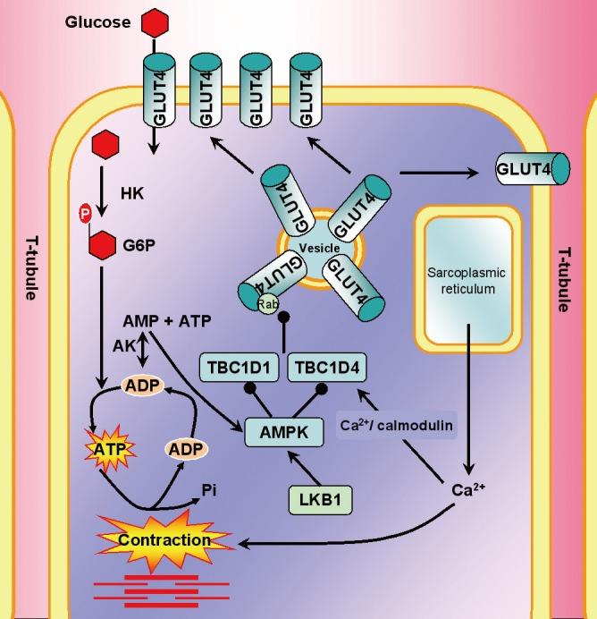
Exercise dependant Glucose Uptake
This is a muscle
Fiber, Glut 4
Receptors take
Up the glucose
From the blood
When it
contracts!

Slide 12
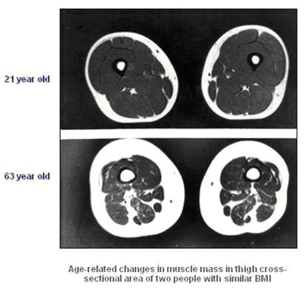
Muscle atrophy with aging- dont use it, lose it….

Slide 13
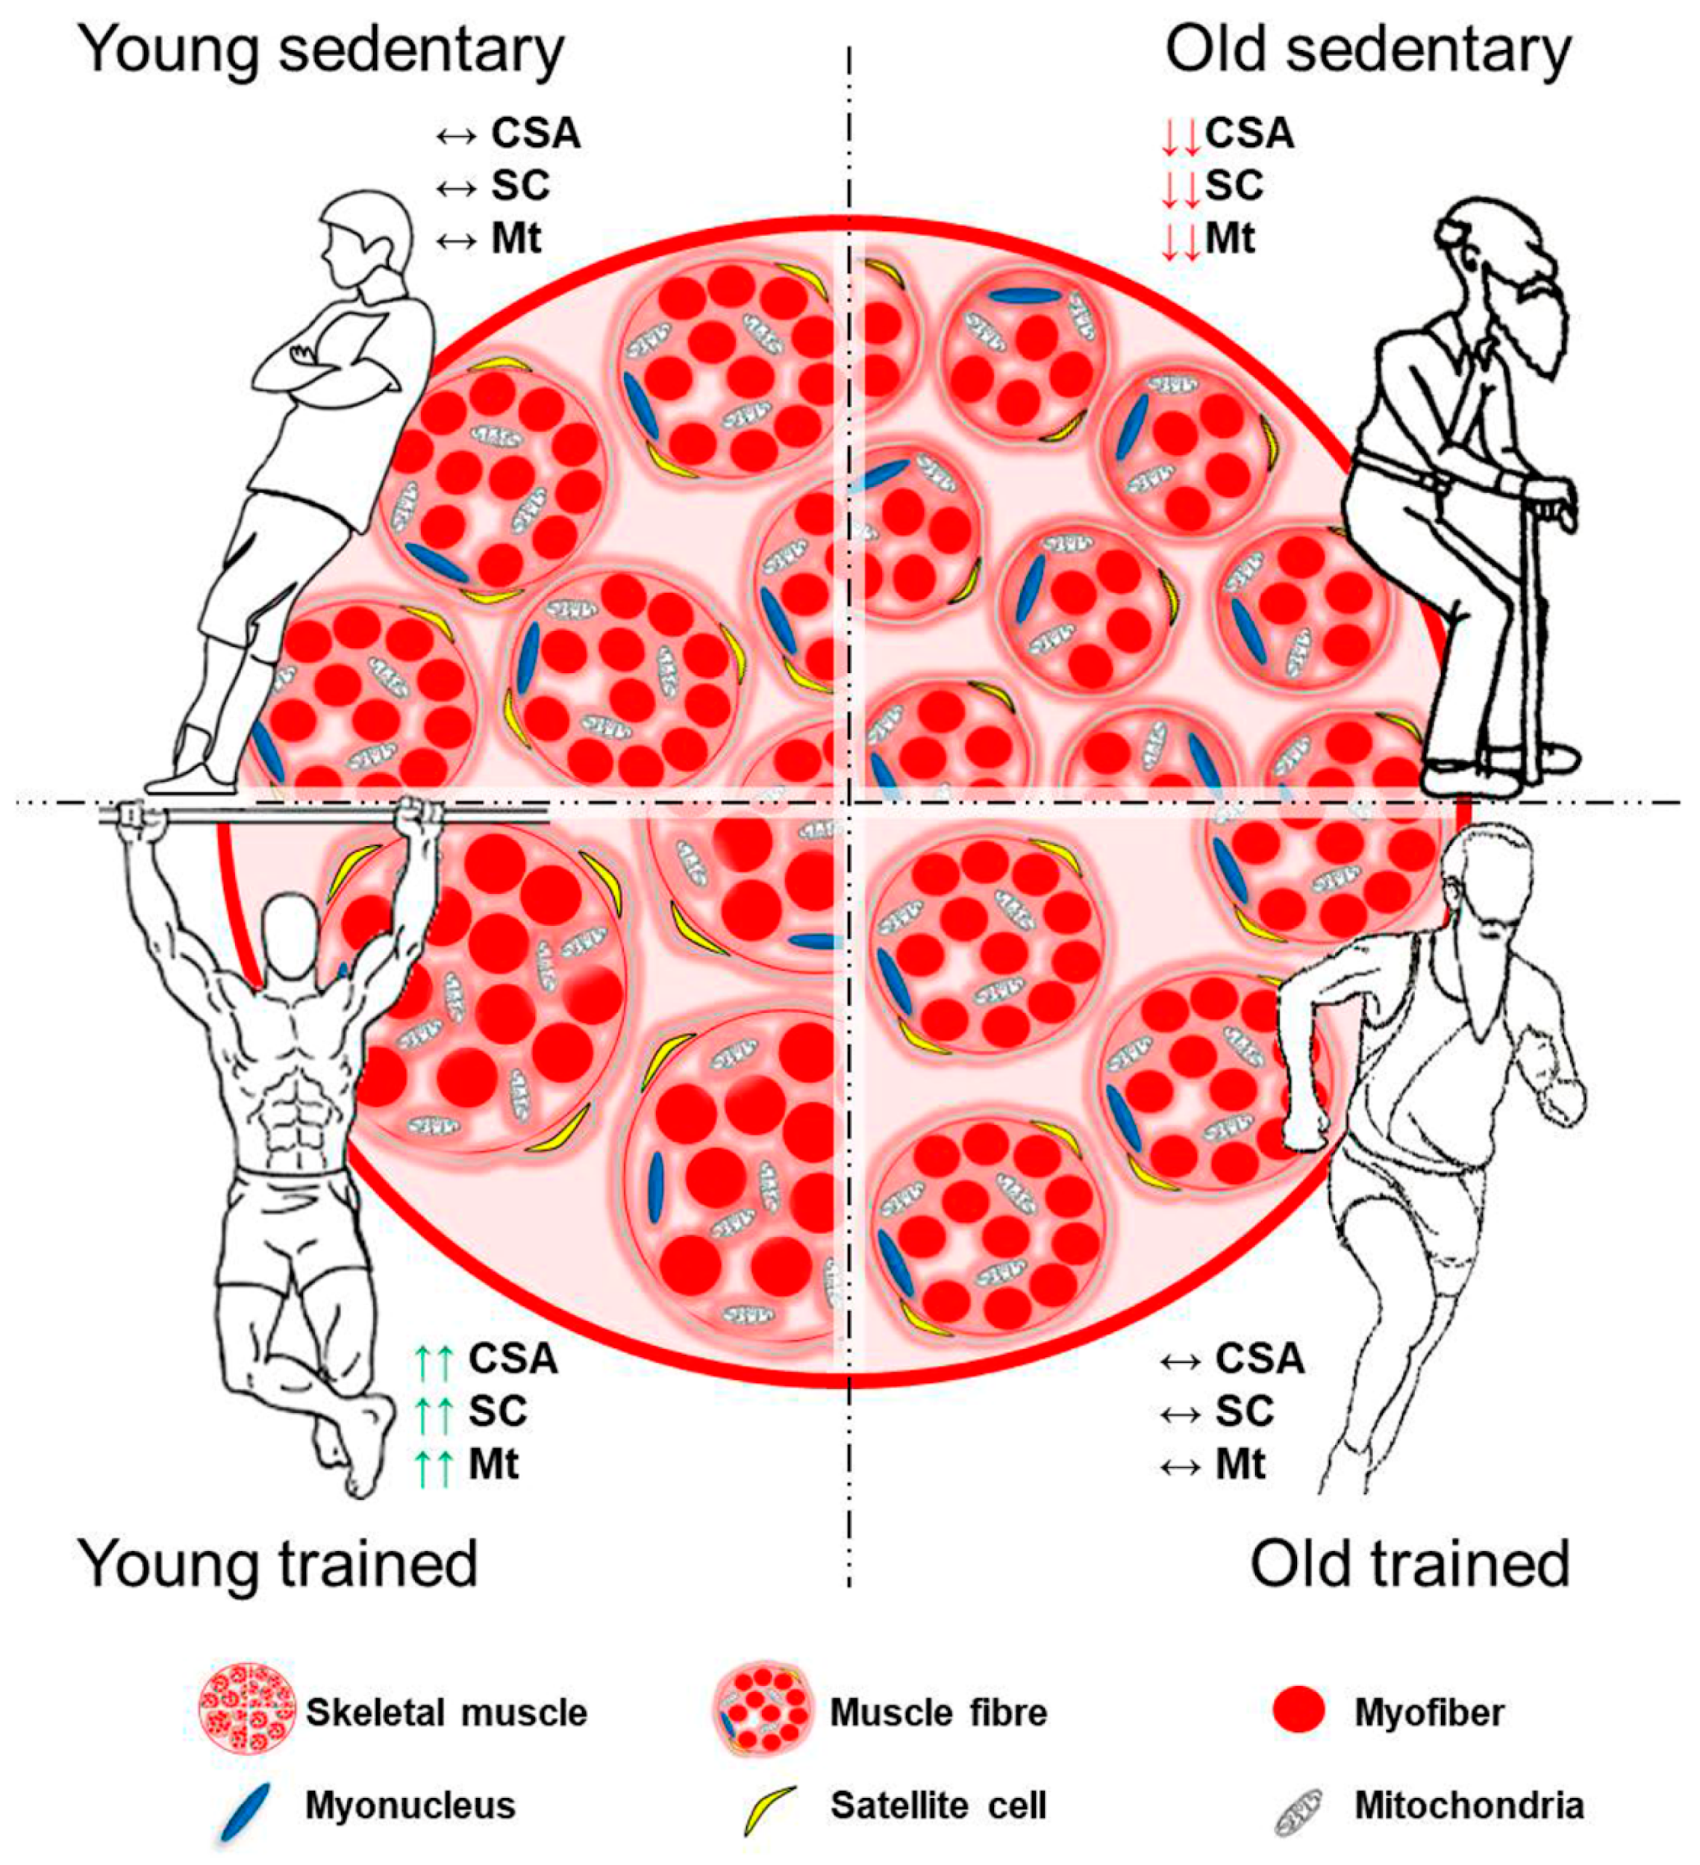
Keep your muscle fibers !
They are much
Better than a
Fat cell!

Slide 14
Because glucose gets used up!

Slide 15
"Little Things" is a 19th-century poem by Julia Abigail Fletcher Carney, written in Boston, Massachusetts.
Little drops of water,
Little grains of sand,
Make the mighty ocean
And the pleasant land.
Thus the little minutes,
Humble though they be,
Make the mighty ages
Of eternity.

